Slide 1

CG exlDigital

Slide 2

Why exlDigital ?
Interview readiness program
Mentee : Self-evaluation
Digital Assessment
Super Admin - Assessment score review
Identity & mitigate skill gaps - Mentoring, Hands-on Assessment
CI – Question bank
Mentee : Email Notification : JD, Assessment, Notify Mentor Connect
Mentor : Technical/Non-technical gaps to fill up
Account Owner : Source of JD & Skills
L&D, WFM : Request Mentee, Generating auto/manual assessment email, Track progress exlDigitally

Slide 3
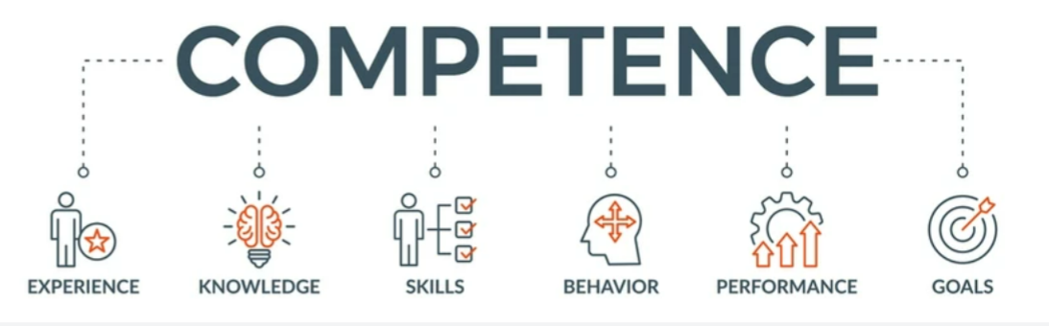
What exlDigital do?
//txt to add//

Slide 4
Problem
Automate skill evaluator
Quick skill gap evaluation
Few, if any, products on the market help customers like we do
Millennials account for about a quarter of the $48 billion spent on other products in 2018
Mentoring with skill gap
Connect : Super Admin = WFM = Mentor = Account Owner
66% of US consumers spend money on multiple products that only partially resolves their issue
Loss of productivity costing consumers thousands of dollars

Slide 5

Solution
Close the gap
Our product makes consumer lives easier, and no other product on the market offers the same features
Target audience
Gen Z (18-25 years old)
Cost savings
Reduce expenses for replacement products
Easy to use
Simple design that gives customers the targeted information they need

Slide 6

exlDigital App Overview
Unique
Tested
Only product specifically dedicated to this niche market
Conducted testing with college students in the area
First to market
Authentic
First beautifully designed product that's both stylish and functional
Designed with the help and input of experts in the field

Slide 7

exlDigital benefits
Cool and stylish product
Areas for community connections
Online store and market swap

Slide 8

Login exlDigital

Slide 9



Business model
Research
Abstract
Design
We based our research on market trends and social media
We believe people need more products specifically dedicated to this niche market
Minimalist and easy to use

Slide 10

Market overview
$3B
$2B
$ 1B
Opportunity to build
Fully inclusive market
Total addressable market
Freedom to invent
Selectively inclusive market
Serviceable available market
Few competitors
Specifically targeted market
Serviceable obtainable market

Slide 11



Market comparison
$3B
Opportunity to build
Addressable market
$2B
Freedom to invent
Serviceable market
$1B
Few competitors
Obtainable market

Slide 12
Our competition
Contoso
Competitors
Our product is priced below that of other companies on the market
Design is simple and easy to use, compared to the complex designs of the competitors
Affordability is the main draw for our consumers to our product
Company A Product is more expensive
Companies B & C Product is expensive and inconvenient to use
Companies D & E Product is affordable but inconvenient to use

Slide 13
Competitive layout
CONVENIENT
A
Contoso
EXPENSIVE
AFFORDABLE
D
C
E
B
INCONVENIENT

Slide 14
Growth strategy
How we’ll scale in the future
Feb 20XX
May 20XX
Oct 20XX
Roll out product to high profile or top-level participants to help establish the product
Release the product to the general public and monitor press release and social media accounts
Gather feedback and adjust product design as necessary

Slide 15
Traction
Forecasting for success
Key metrics
Revenue by year
 | Clients | Orders | Gross revenue | Net revenue
20XX | 10 | 1100 | $10,000 | $7,000
20XX | 20 | 200 | $20,000 | $16,000
20XX | 30 | 300 | $30,000 | $25,000
20XX | 40 | 400 | $40,000 | $30,000

Slide 16
Two-year action plan
Draft blueprints
Run focus groups
Gather feedback
20XX
JAN
FEB
MAR
APR
MAY
JUN
JUL
AUG
SEP
OCT
NOV
DEC
20XX
JAN
FEB
MAR
APR
MAY
JUN
JUL
AUG
SEP
OCT
NOV
DEC
Test design
Launch design
Deliver to client

Slide 17
Financials
 | Year 1 | Year 2 | Year 3
Income
Users | 50,000 | 400,000 | 1,600,000
Sales | 500,000 | 4,000,000 | 16,000,000
Average price per sale | 75 | 80 | 90
Revenue @ 15% | 5,625,000 | 48,000,000 | 216,000,000
Gross profit | 5,625,000 | 48,000,000 | 216,000,000
Expenses
Sales & marketing | 5,062,500 | 38,400,000 | 151,200,000 | 70%
Customer service | 1,687,500 | 9,600,000 | 21,600,000 | 10%
Product development | 562,500 | 2,400,000 | 10,800,000 | 5%
Research | 281,250 | 2,400,000 | 4,320,000 | 2%
Total expenses | 7,593,750 | 52,800,000 | 187,920,000

Slide 18
Funding
Properties
Angel investments
Cash
Shares
$12,000
$14,000
$32,000
$82,000
Revenue obtained from property rentals
Amount obtained through other investors
Liquid cash we have on hand
Number of shares converted into USD

Slide 19




Meet the team
Takuma Hayashi
Mirjam Nilsson
Flora Berggren
Rajesh Santoshi
President
Chief Executive Officer
Chief Operations Officer
VP Marketing

Slide 20

Summary
exlDigital interview readiness program & help mentee to upskill & get through the CI
Identify skills & right opportunity
Identify skills gaps from PU Pool
Mentor & guide

Slide 21

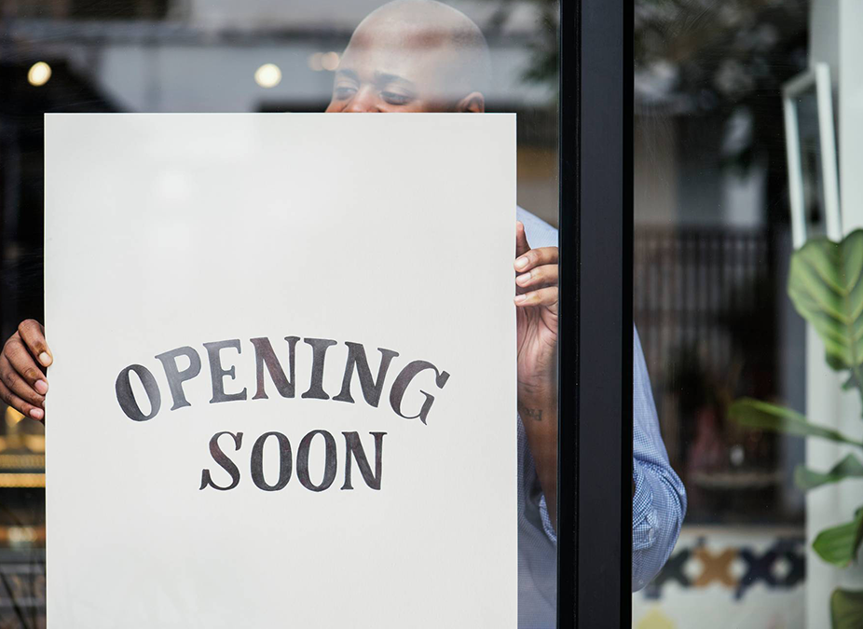
Thank you
exlDigital

